Slide 1

NASA Landslide Global Fatality Data Analysis Project
Data 670 Data Analytics
Bohannon Smith
Professors Dr. Marion Smith and Dr. Jon McKeeby

Slide 2
Data Analysis Project Description
As the lead of a data analytics team contracted to NASA for project designed to address why the United States falls within a list of countries with moderate to high fatalities from landslides.
Analysis of the landslide data will guess to why the U.S has such a high fatality rate due to landslides although being one of the most well developed and wealthiest countries in the world.
I will be address specific technology needs as well as a broader view of data integration using data integration techniques though the use of IBM Watson analytics.
Notes:
This presentation includes a comprehensive report including the background of the project, specific goals and objectives, the research conducted to address the objectives, results obtained, conclusions reached and detailed recommendations. I will also present the key findings in a PowerPoint presentation.

Slide 3
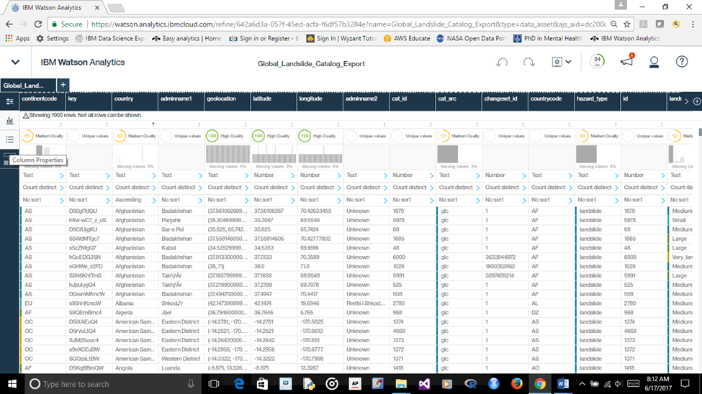
Describe the Data
Global Landslide Catalog Export
The Global Landslide Catalog (GLC) was developed with the goal of identifying rainfall-triggered landslide events around the world, regardless of size, impacts or location. The GLC considers all types of mass movements triggered by rainfall, which have been reported in the media, disaster databases, scientific reports, or other sources. The GLC has been compiled since 2007 at NASA Goddard Space Flight Center.

Slide 4
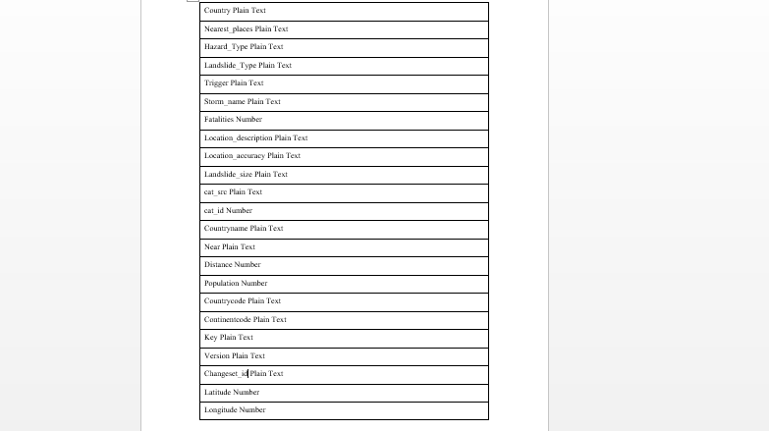
List of Variables

Slide 5
Data Analysis Strategy
Using IBM Watson Analytics we will inspect and read the data while assessing it for data quality. Watson issued a data quality score to all of the columns which enabled me to delete data of poor quality that will possibly sabotage the data by calculating the degree to which the data is appropriate for predictive analysis.
Integration of the Systemic Approach which coalesces and distillates on the interaction between elements while studying the effects of interactions. We will be emphasizing the global fatality rate in comparison to the US while modifying groups of variables concurrently.
Notes:
…..data sets with low quality scores may be suitable for data examination even if they are not suitable for predictive analysis. The overall score is an average of the data quality score for every field in the data set, as determined by missing and constant values, influential categories, outliers, disproportion and skewness. An instance of this would be to eliminate fields with more than 25% misplaced values and fields with constant values.”
Cite: IBM Watson Analytics Quality In, Quality Out, McKinley Stacker IV
https://www.ibm.com/communities/analytics/watson-analytics-blog/quality-in-quality-out/

Slide 6
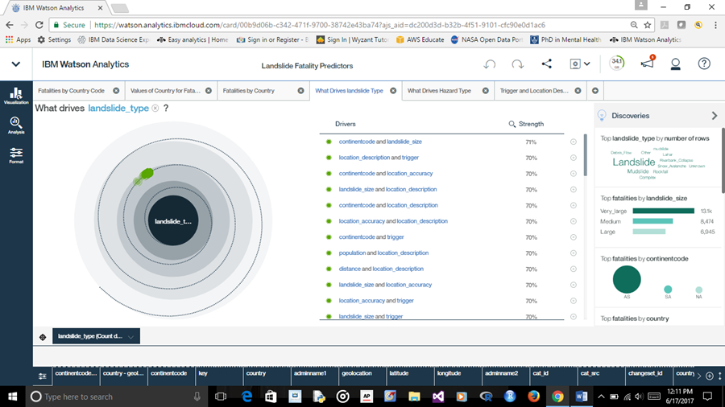
What drives landslide type? The highest predictor shown here is continent code which coincides with the data due to the fact of India’s and China’s high landslide fatality rate.

Slide 7
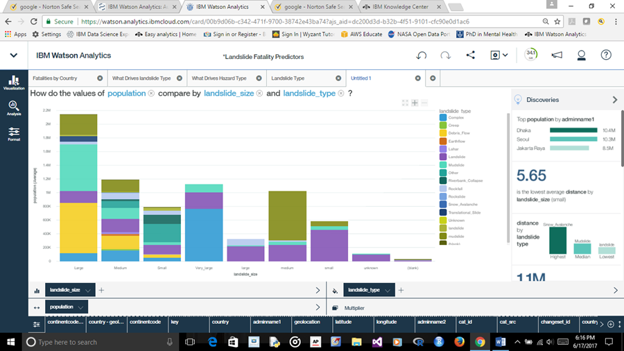
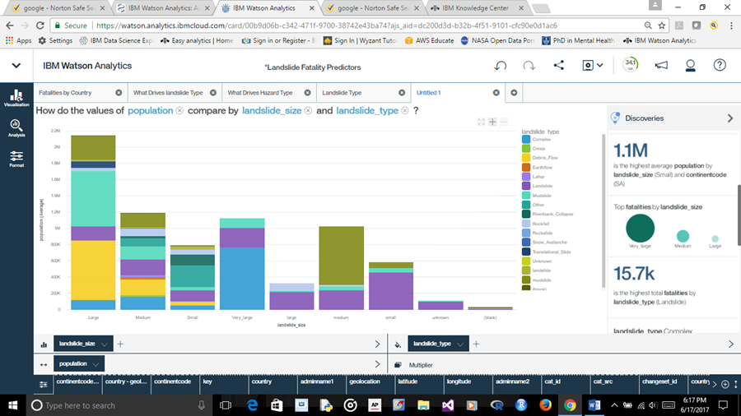
In Figure 3 I ask the question how the values of population compare by landslide size and landslide type. The bar charts show mudslides as the mean type. In figure 4 the landslide type median is shown as the teal representation the bar chart. In figure 5 Sri Lanka is show as the country with the median value for population. Figure #3 – Mudslide as Mean Type Figure 4 – Landslide Type Median

Slide 8
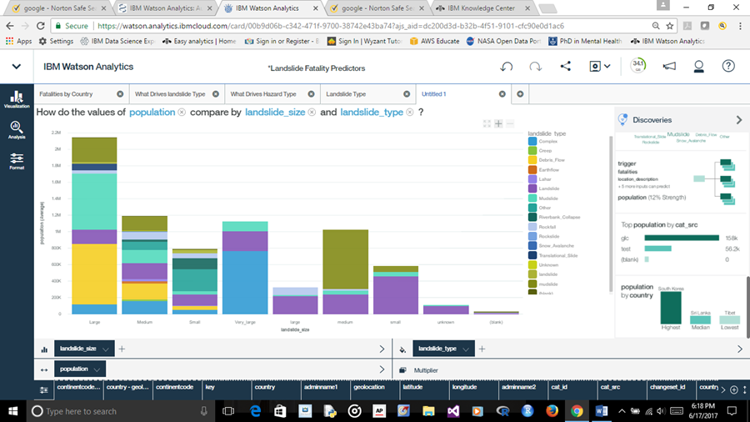
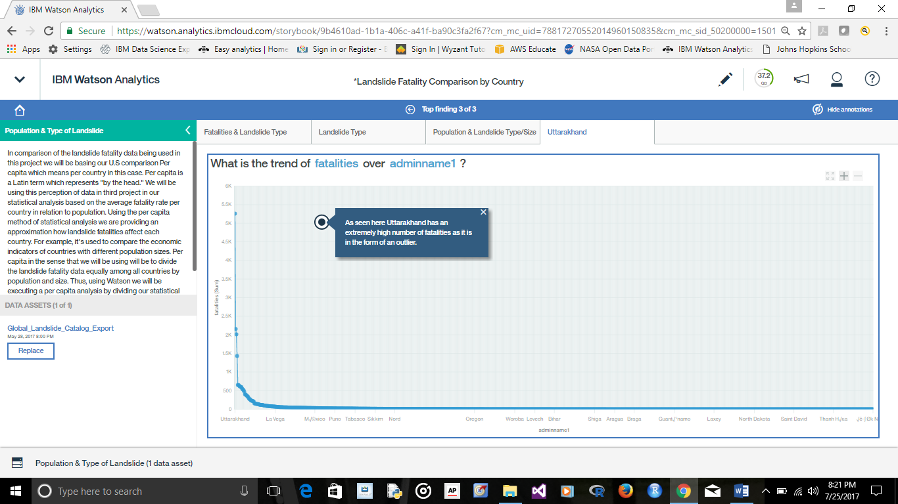
Figure #5( Left) – Sri Lanka as Median Population Figure #6 (Right) - Uttarakhand highest number of fatalities

Slide 9
Recommendations: Data Collection & Accountability
There is little information on the historical occurrence of landslides at the global scale; information is mostly based on media reports, online databases, and other sources.
Fewer than 5% of the fatalities were reported in North America, suggesting a significant amount of under-reporting in other regions (Kirschbaum, Stanley, & Zhou, 2015).
Notes:
This information sheds light on an alarming fact since the U.S is shown having a relatively high fatality rate due to landslides and if only 5% of the fatalities are reported this would put the U.S at a very high rate depending on the report rate of other countries.

Slide 10
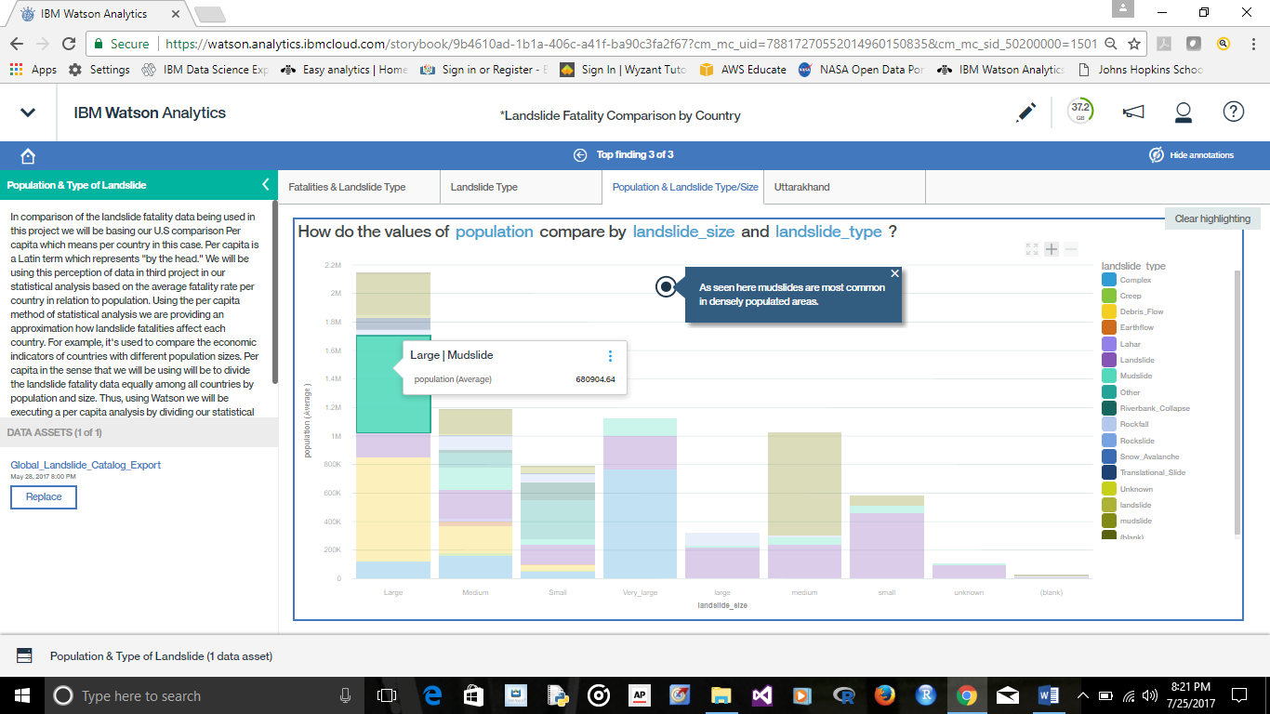
Recommendations: Education & Prevention
Approximately 60% of the reported landslides have daily precipitation exceeding the 95th percentile of precipitation which would place precipitation as a very strong predictor of landslides (Kirschbaum, Stanley, & Zhou, 2015).
Notes:
Since floods and landslides often occur in a cascading manner, thus posing significant risk, losses that are significantly greater than the sum of the losses from the hazards when acting separately are acquired (Ke, Xianwu, Yang, Gourley, Ning, Zhanming, & Wooten, 2016).

Slide 11
Lessons Learned
Previous studies on the connection between rainfall, hydrological processes and slope stability, and landslide fatalities provide a useful prototype model system for operational forecasting of flood and landslide (Ke, Xianwu, Yang, Gourley, Ning, Zhanming, & Wooten, 2016).”
Promotion and advocacy for data collection. We need to communicate with other countries that have high fatality rates that it is important to report fatalities and practice efficient data collection.

Slide 12
Next Steps
Next I will get more involved in the actual account of the techniques used in the collection of this data and how it can be improved. I will also do further research on the evaluation of data in regards to the statistical significance tests and training set results.

Slide 13
References
Alcántara-Ayala I, López-García J, Garnica R. On the landslide event in 2010 in the Monarch Butterfly Biosphere Reserve, Angangueo, Michoacán, Mexico. Landslides [serial online]. June 2012;9(2):263-273. Available from: Academic Search Complete, Ipswich, MA. Accessed June 14, 2017.
Dowling, C., & Santi, P. (2014). Debris flows and their toll on human life: a global analysis of debris-flow fatalities from 1950 to 2011. Natural Hazards, 71(1), 203-227. doi:10.1007/s11069-013-0907-4
Google - https://www.google.com. Cover Page Photo
Hoyt, R. E., Snider, D., Thompson, C., & Mantravadi, S. (2016). IBM Watson Analytics: Automating Visualization, Descriptive, and Predictive Statistics. JMIR Public Health and Surveillance, 2(2), e157. http://doi.org/10.2196/publichealth.5810
IBM.com - https://www.ibm.com/support/knowledgecenter/en/SS4QC9/com.ibm.solutions.wa_an_overview.2.0.0.doc/c_wa_an_ovrvw_stat_tests.html#c_wa_an_ovrvw_stat_tests
IBM.com - https://www.ibm.com/support/knowledgecenter/en/SS4QC9/com.ibm.solutions.wa_an_overview.2.0.0.doc/wa_discover_viz_analysis_panel.html
IBM Watson Analytics Quality In, Quality Out, McKinley Stacker IV
https://www.ibm.com/communities/analytics/watson-analytics-blog/quality-in-quality-out/
IBM.com https://www.ibm.com/support/knowledgecenter/en/SS4QC9/com.ibm.solutions.wa_an_overview.2.0.0.doc/wa_an_hlp_adjust_intro.html
Ke, Z., Xianwu, X., Yang, H., Gourley, J. J., Ning, L., Zhanming, W., & ... Wooten, R. (2016). iCRESTRIGRS: a coupled modeling system for cascading flood-landslide disaster forecasting. Hydrology & Earth System Sciences, 20(12), 5035-5048. doi:10.5194/hess-20-5035-2016
Kirschbaum, D., Stanley, T., & Zhou, Y. (2015). Spatial and temporal analysis of a global landslide catalog. Geomorphology, 249 (Geohazard Databases: Concepts, Development, Applications), 4-15. doi:10.1016/j.geomorph.2015.03.016
Kirschbaum, D. B., Adler, R., Hong, Y., Hill, S., & Lerner-Lam, A. (2010). A global landslide catalog for hazard applications: method, results, and limitations. Natural Hazards, 52(3), 561–575. doi:10.1007/s11069-009-9401-4. [1]
Microsoft.com - https://docs.microsoft.com/en-us/azure/data-catalog/data-catalog-how-to-data-profile
NASA.com
“This dataset on data.nasa.gov was a one-time export from the Global Landslide Catalog maintained separately. It is current as of March 7, 2016. The original catalog is available here: http://ojo-streamer.herokuapp.com/”
Rawat, M. S., Uniyal, D. P., Dobhal, R., Joshi, V., Rawat, B. S., Bartwal, A., & ... Aswal, A. (2015). Study of landslide hazard zonation in Mandakini Valley, Rudraprayag district, Uttarakhand using remote sensing and GIS. Current Science (00113891), 109(1), 158-170.
Rosnay J de. (1997 &1979) Analytic vs. Systemic Approaches

Slide 14

Questions

